Slide 1
Row Level Security only
Skip the PBI Security section and jump straight to
Could do specific RLS from slides 8.2 starting on slide 30-38
AND then follow on with new DevIAD slides see Lab 02 PBIEmbedded from slide 43 - 58

Slide 2
Power BI Security
Follow this with youtube video https://www.youtube.com/watch?v=3gpMacpLq44
By Kasper De Jonge
Start slide 9
Read in collaboration with latest PBI Security Whitepaper https://docs.microsoft.com/en-us/power-bi/service-admin-power-bi-security

Slide 3
Welcome! Power BI User Group (PUG)
Copenhagen

Slide 4
Power BI Security
Kasper de Jonge
Senior Program Manager

Slide 5
Please update this deck before presenting it
This deck is current as of August 2017, Power BI moves in a rapid cadence and much can and will change over time.
To get the latest information please visit:
Power BI Security whitepaper
Power BI trust center

Slide 6



Agenda
User Identity
Data Security
Compliance & market availability
How can you secure your content?
10101101011010110101101011010110101101011010110101101011010110101101011010110101101011010110

Slide 7
User Identity

Slide 8
User Identity
Power BI is part of the larger Microsoft cloud, it all runs on Azure!
Security system is built on Azure Active Directory
Already using other Office 365 services? same tenant!
Azure Active Directory (AAD) will be used to secure all of your MS resources with a common set of users and groups.

Slide 9
User Identity
Choosing your identity infrastructure is key!
Managed Identities (Password Sync?)
Federated Identities (AD FS? 3rd party STS?)
If you have an on-premises directory/IDM you already manage, set up AAD Connect so you only manage once
Every user can sign up for a free Power BI license (this can be turned off)
Notes:
https://docs.microsoft.com/en-gb/azure/active-directory/connect/active-directory-aadconnect
https://channel9.msdn.com/Events/Ignite/2015/BRK3862?ocid=player

Slide 10
Power BI Security
Start 3:50 – 9:00 min : User Identity
9:00 – 12:24 : Power BI Authentication

Slide 11


Power BI Authentication
ATM (Azure Traffic Manager)
AAD
Azure CDN
WFE
Global Service
(Azure Table)
ASP.NET
Backend Service
Browser
app.powerbi.com
Microsoft Login

Slide 12
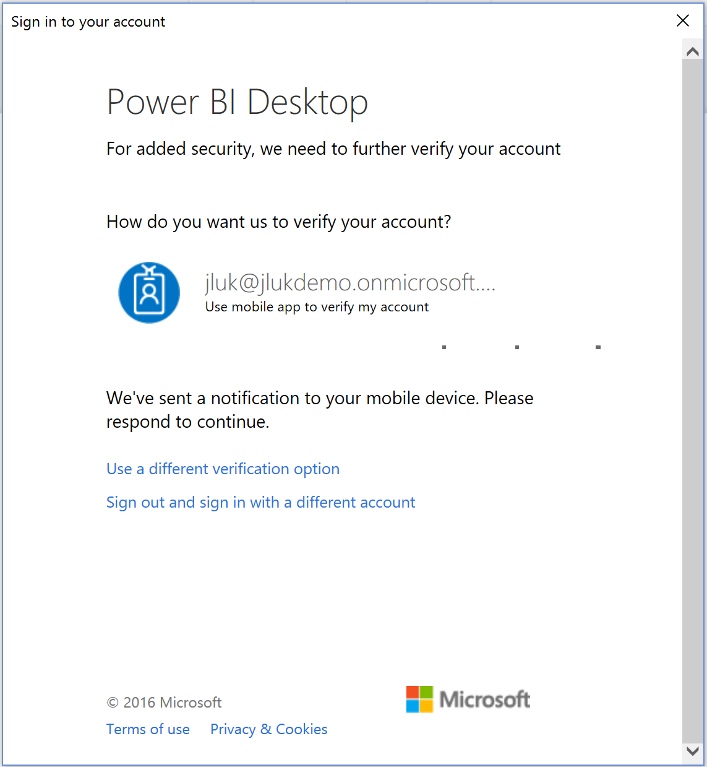
User Access Control
Azure AD supports Multi-Factor Authentication for Users
Enabled through the Admin Portal
Requires O365 or AAD Premium
Multi-Factor Auth can be enabled in Azure AD, or in your on-premises IDP (i.e. ADFS)
Azure AD: phone call, text, Azure Authenticator App
On-prem IDP: anything your IDP supports

Slide 13
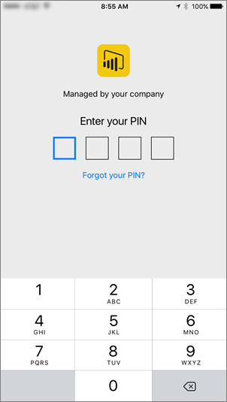
User Access Control
Mobile Device/App Management:
Controlled via Intune for Power BI Mobile apps on iOS (7+) /Android(4+)
Policies such as:
Require PIN
Max failed PIN attempts
Configuring InTune:
Specify the app
Configure policies (i.e. require PIN)
Enable for deployment
End-users install from Company Portal app
Full process and InTune details documented here

Slide 14
User Access Control
Conditional Access for Web and Mobile available through Azure AD
Control which IP ranges can connect (corp net?)
Control which devices can connect
Only certain users can connect (groups)
When to do 2FA
And much more combinations..
Azure AD Tenant Restrictions
Control access to SaaS cloud applications, based on the Azure AD tenant

Slide 15
Power BI Security
Start 3:50 – 9:00 min : User Identity
9:00 – 12:24 : Power BI Authentication
20:45- : Admin Demo
Usage Metrics / Users (O365) /
22:25 Audit Logs – 28:00 (PBI Admin Audit Logs I can do )
Data Security upto Compliance 27:24 - 50:45

Slide 16
Admin Control
Administrators can control sign up:
whether users can self-sign up to Power BI
add them manually
NOTE: this config is shared with Office 365
Fine grained admin controls:
Control who can share content
Control who can export data
Control who can create content packs
And more to come!

Slide 17
Admin controls demo we will do them with slides 9.04 later.

Slide 18
Power BI Security
Data Security OK good listen to Kasper if time else I can do quicker
Data Security upto Compliance 27:24 - 50:45 (23 mins !!!)

Slide 19
Data Security

Slide 20
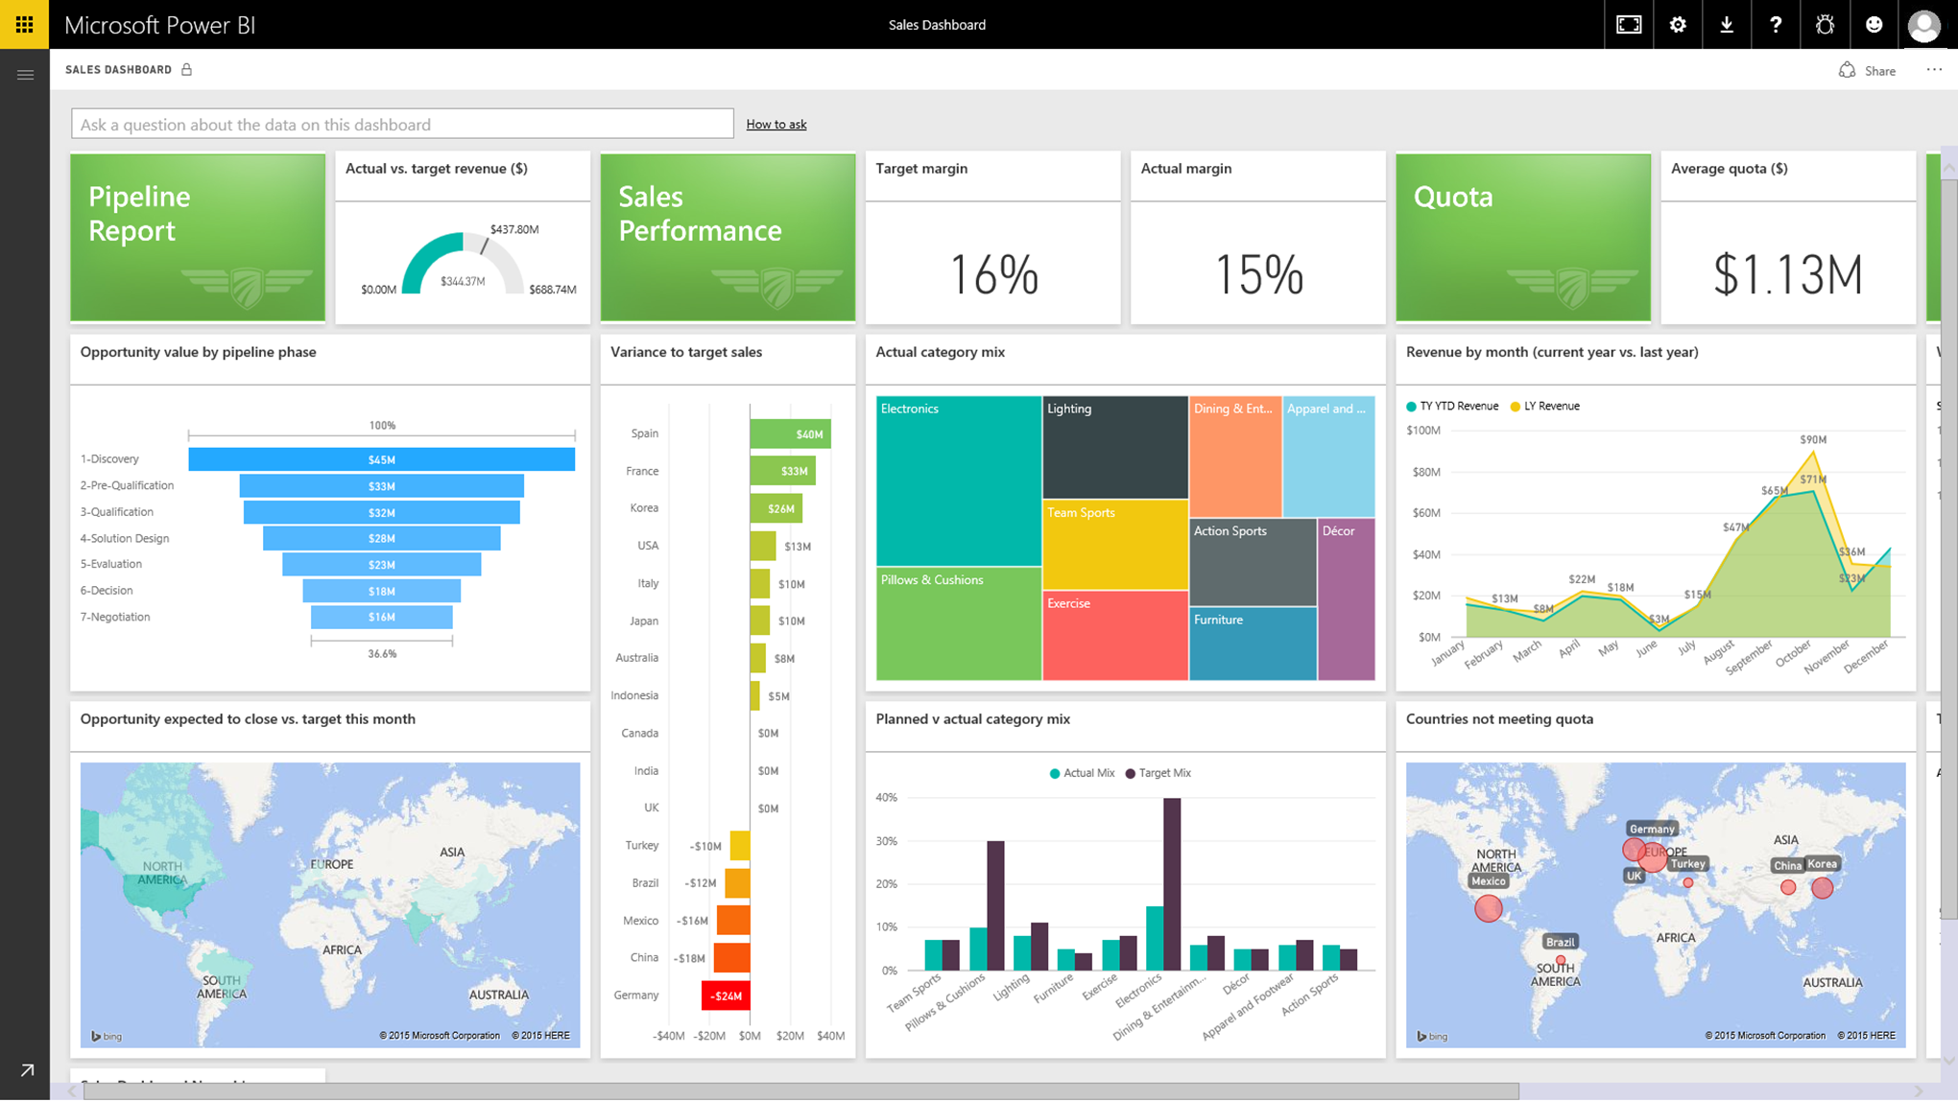
Types of data in Power BI
Access to data any way you like
Imported data
Data is moved to Power BI and leveraging it’s in memory engine.
Uses saved credentials to refresh
Live connection or Direct Query
Data is stays in original location
Uses saved credentials or passes username to data source directly.
Pushed data
Data is pushed to Power BI and leveraging it’s in memory engine.
Live Power BI reports & dashboards
Azure
AD
Cloud
Live connection or
scheduled refresh
On-premises
SQL / Oracle / Spark
SQL Server Analysis Services
AD

Slide 21
How Power BI handles data
Generally data is either In Process or At Rest
Data in transit between Power BI and data source is always encrypted via HTTPS
Depending on the data source, data may be stored in the service, or retrieved “just in time”… but always encrypted.

Slide 22
What types of data at rest are there?
The data itself is the dataset
The credentials to connect to the data sources
The metadata is the report / dashboard layout itself
The visual cache is used to cache dashboards (can be tuned)

Slide 23
Data at Rest, where is it stored?
Data Source | Metadata/Visual cache | Credentials | Data
Analysis Services (on-prem or Azure) | Nothing stored except reference to DB in Azure SQL, Encrypted. Visual cache stored in Azure BLOB storage, Encrypted | Stored in Azure SQL, Encrypted | Nothing stored at rest in Power BI service.
Direct Query | Stored in Azure BLOB storage, Encrypted | Model created in service: stored as part of connection string stored in Azure BLOB storage, Encrypted Imported from desktop: Stored in Azure SQL, Encrypted | Nothing stored at rest in Power BI service.
Pushed data (i.e. non-Direct Query, non-AS on-prem) | Stored in Azure BLOB storage, Encrypted | (Not applicable) | Stored in Azure SQL, Encrypted
ETL/Cached data | Stored in Azure BLOB storage, Encrypted | Salesforce/OneDrive: refresh tokens stored in Azure SQL DB, Encrypted Refresh dataset: stored in Azure SQL DB, Encrypted Non-refresh dataset: No credentials stored | Stored in Azure BLOB storage, Encrypted

Slide 24
How is the data encrypted?
The encryption keys to Azure Blob keys are stored, encrypted, in a separate location in the Power BI service. Fully managed by an internal Microsoft service.
The encryption keys for Azure SQL Database TDE technology is managed by Azure SQL itself.
The encryption key for credentials are stored:
On-prem data sources: In the data Gateway on the customer’s infrastructure
Cloud-based data sources: In the Data Movement Role using Azure SQL encryption
Notes:
Azure SQL DatabAse TDE = Transparent Data Encryption

Slide 25
Power BI Data Storage Architecture
WFE
Back End
Global Service
(Azure Table)
Azure SQL
Database
Service Bus
Azure
Redis Cache
Azure
Service Fabric
Azure API
Management
Presentation
Role
Azure
BLOB
Gateway
Role
Azure Blob: User uploaded data
Azure SQL DB: Metadata/Data
Data in Azure SQL DB has TDE enabled
and Azure Blob data is encrypted.
Background Job Processing Role
Data
Role
Data Movement Role

Slide 26
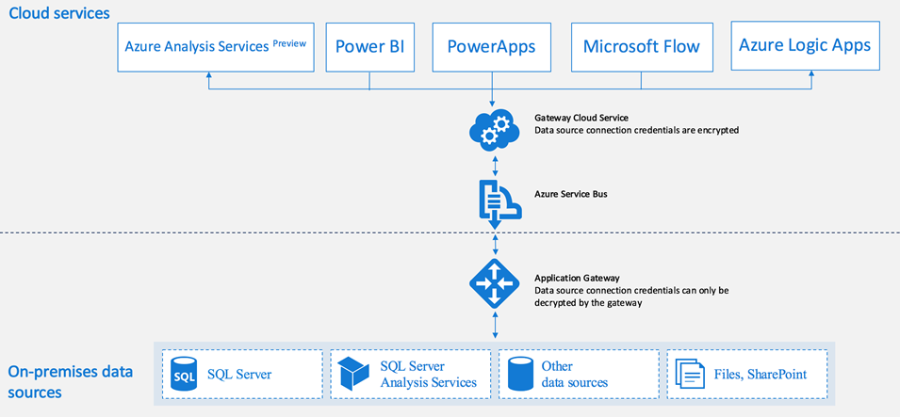
On premise data dateway security
Data source credentials encrypted using asymmetric encryption so that they cannot be decrypted in the cloud
The credentials are sent to the machine, running the gateway, on-premises where they are decrypted when the data sources are accessed.
The On-premises Data Gateway uses data compression, as well as transport encryption.

Slide 27
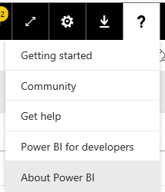
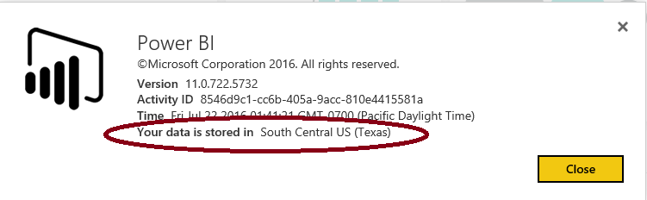
Where is my data stored?
Is my data stored in same region?
Europe | North Europe (Ireland) West Europe (Netherlands)
Data Sovereignty
Australia | Australia East (New South Wales) Australia Southeast (Victoria)
United Kingdom | UK South (London, England) UK West (Cardiff, Wales)

Slide 28
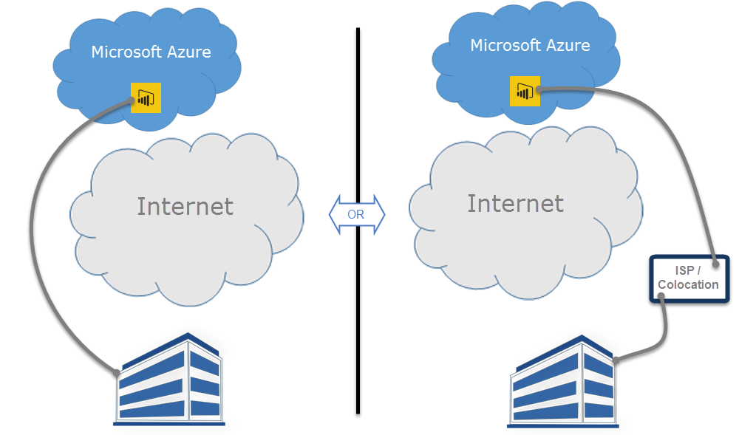
Express route support
Allows you to create a private network connection from your organization to Power BI (or using an ISP’s colocation facility)
Part of the Azure Express route functionality (Power BI uses Public peering)

Slide 29
Compliance & market availability

Slide 30
Compliance and market availability
Compliance | Availability
ISO/IEC 27001: 2013 | ✔
ISO/IEC 27018:2014 | ✔
HIPAA BAA | ✔
EU Model Clause | ✔
Data Processing Terms | ✔
PCI Security Standards Council | ✔
CSA STAR Certification | ✔
G-Cloud (UK) | ✔
Section 508 VPATs | ✔
SOC 1, SOC 2 & SOC 3 (SSAE 16) | ✔
Sarbanes-Oxley | ✔
HITRUST | Coming soon
FedRAMP High (in Azure Government environment) | ✔
Regions (data locations) | Availability
Asia Pacific | ✔
Australia | ✔
Brazil | ✔
Canada | ✔
Europe | ✔
India | ✔
Japan | ✔
United Kingdom | ✔
United States | ✔
National clouds | Availability
US Government | ✔
China | ✔
Germany | ✔
All dates are subject to change; this information is a best estimate based on June 2017. Audit schedules are hard to predict and can be outside Microsoft’s control. Some certifications have an annual audit window and failure to pass the audit could result in a 1 year delay.
Notes:
Please refer to the monthly Power BI desktop release blog posts, service update blog posts, and mobile update blog posts for details about recently released features

Slide 31
How can you secure your data?

Slide 32
How to secure your content
Data in your workspace is yours alone
You can share dashboards with others to see
You can create an App Workspace to collaborate with others
You can distribute an App for consumption to users inside (and outside*) your organization using AppSource or direct URL
You can secure rows of data with Row Level Security
*this is a roadmap item

Slide 33
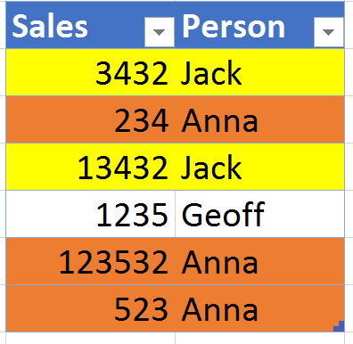
Using Row Level Security
RLS means Row Level Security
It allows you to control what data a report user can see
Can be used in Power BI and Analysis Services
Additionally security can also be added through SSAS like object level security, SSO and Always Encrypted

Slide 34
Configure RLS demo

Slide 35
Dynamic Row Level security
Dynamic Row Level Security allows you to determine which rows of data are available based on data in the model.
Reduces maintenance costs
Allows updates by just refreshing data
Used by most enterprise models

Slide 36
Setting up dynamic RLS
Use Bi-Directional cross filtering and a particular model that stores usernames
Use a single DAX function =USERNAME() to initiate security
Two functions available:
USERNAME = current user’s the domain and username
USERPRINCIPLENAME = current user’s name in UPN

Slide 37
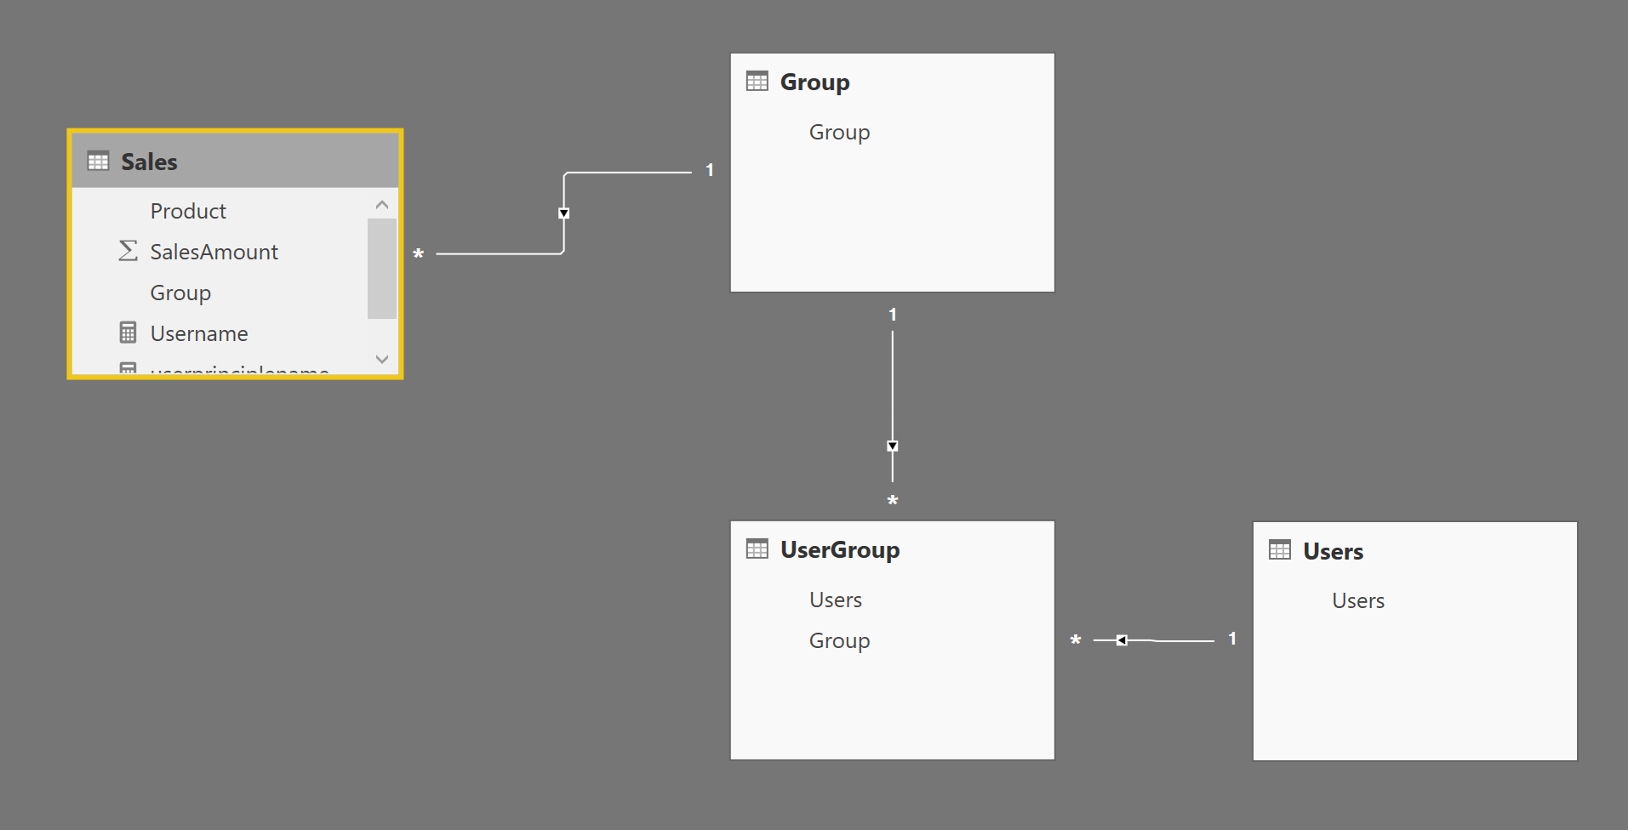

Filter by Groups of this user
Filter by Groups of this user
Filter by Username
Filter by Username

Slide 38
Dynamic RLS demo

Slide 39
More reading
Power BI Security whitepaper
Power BI trust center
Dynamic row level security cheat sheet
Whitepaper: Bidirectional Cross Filtering
Power BI and Expressroute
Securing the Tabular model and Power BI whitepaper
Power BI app distribution

Slide 40
Thank you for Attending!
Don’t forget to join your local PUG to enjoy year-round networking and learning.
www.pbiusergroup.com/denmark
www.pbiusergroup.com/sweden
www.pbiusergroup.com/gebruikersgroep

